Slide 1
Project Charter Template
Date

Slide 2
Project Description & Scope
A summary/description of the work product or service to be provided. Define the customer for the proposed product or service (can be an internal or external customer). If the project is part of a larger coordinated effort, state how the project fits within the context of the larger effort.
Describe from a quantitative perspective what is to be accomplished by the project. Include a boundary statement of what is not included in the scope of the project.
Project Description
- Our team is tasked with assisting (INSERT STATES) in the reopening and recovery process from the COVID-19 pandemic. We will develop metrics and graphics for risk-assessment and safety guidance.
Scope
- Deliverable #1—A Touch Screen or Point and Click Fishbone GUI for Local Residents To Predict Personal Risk and Guide Appropriate Mitigations
- Deliverable #2—Tripwire Metric: Weekly Regional Mortality Actual Versus Normal
- Deliverable #3—Tripwire Metric: Forecast of Local Hospital Max Capacity
- Deliverable #4—Community Vulnerability Map in Tableau or Power BI

Slide 3
Sponsors, Stakeholders and Roles & Responsibilities
Names, titles, organizational affiliation of the business leader(s) who are sanctioning the initiative. Project sponsors provide approval signatories for the project and perform phase exit approvals.
Names, titles, organizational affiliation of those whose interests may be positively or negatively affected by the project. A stakeholder may also exert influence over the project and its deliverables.
Names, titles, organizational affiliation of key project roles that will be supporting the project.
Sponsors
Stakeholders
Roles & responsibilities

Slide 4
Business Case
A clear and unambiguous description of the business case for the project (problem, opportunity, or business need).
Justification should include a statement of the problem that the proposed project is aimed to solve and a discussion of the business impact and linkage to the Strategic Plan.
Benefits should be quantifiable and measurable. They should be identified as direct or enabled benefits.
Budget for this project/initiative as approved by the AOP Waterline and/or sponsor. Itemize expense, capital and expensed internal labor amounts
Open local communities as quickly as possible yet safely
Restore businesses back to normal operating levels
Restore consumer confidence in the safety of local business establishments
Deploy a risk communication infrastructure at the county level to: 1) aid residents in maintaining hygienic behaviors, 2) inform residents and businesses of emerging risks in their specific geographic areas, and 3) to give guidance to residents in the steps to be taken to avoid risks.
Deploy a set of valid, real time tripwire metrics to provide county and municipal managers with early decision-making guidance for reopening and in responding to future pandemics.

Slide 5
Key Milestones & Deliverables
Summary of all top level and subordinate products and services whose full delivery and acceptance are critical to the successful completion of the project. Include any critical deliverables to be performed by external organizations
Define key project milestones, deliverables and planned finish dates

Slide 6
Critical Success Factors & Risks
A quantifiable criteria that must be met for the project to be considered successful. These could include items such as targets for schedule,
cost (both non-recurring and recurring), performance, quality, etc.
Current metrics and SLAs along with goal metrics must be itemized in this section
Risks include a documented list of known assumptions and constraints for the project.
Enter the score (level of risk and impact of this project) as it relates to Project Categorization, Organizational Change Management and Infrastructure Preparedness .
Critical Success Factors
Risks Constraints & Assumptions
Risk Impact
Project Size: < small, medium, large >
Change Management: < low, medium, high >
Infrastructure Need: < none, simple, complex >

Slide 7
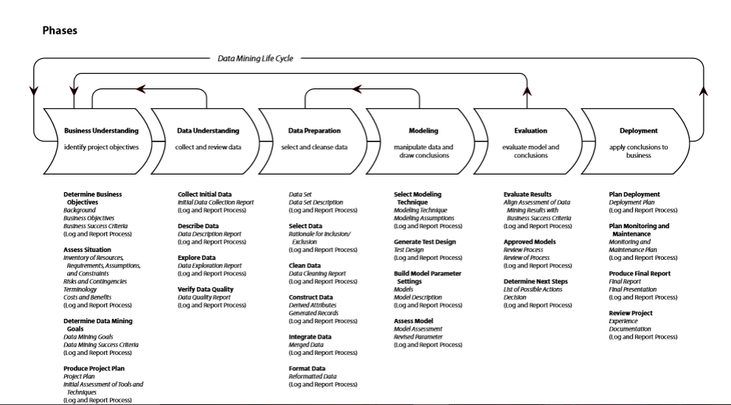
CRISP-DM Project Methodology with Deliverables

Slide 8
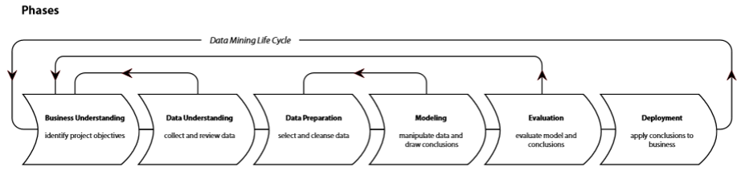
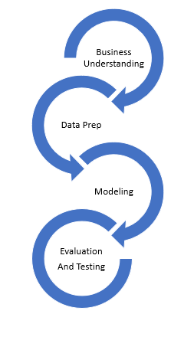
Example of An Agile Life Cycle Implementation
Prototype & Open Questions
Prototype & Open Questions
Deliverable is a report
Deliverable is a workbook
Deliverable is a web service
Action
Action
Action

Slide 9
SPIRAL CHART
Cumulative cost
Progress through steps
1.Determine
objectives
2. Validate Value Props and Identify/ Resolve Risks
Risk analysis
Commitment partition
Risk analysis
Risk analysis
Risk
analysis
Operational Prototype
Prototype 1
Prototype 2
Review
Emulations
Rqts Plan
Life cycle
plan
Concepts of require-
ments
Models
Benchmarks
Requirements
Product
design
Detailed
design
Development plan
Requirements
validation
Code
Integration and test plan
Design validation
And verification
Unit test
4. Plan the next iteration
Integration
3. Development and Test
Test
Implementation

